Slide 1





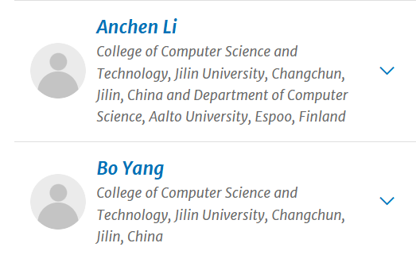



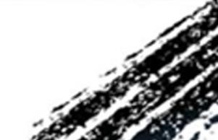

ATAI
Advanced Techniqueof Artificial Intelligence
ATAI
ChongqingUniversity _{AdvancedTechniqueof}
of Technology Artificial Intelligence
Chongqing University of
Technology
Chongqing University ^{ATAI}
_{of Technology} Advanced Techniqueof
Artificial Intelligence
Chongqing University of Technology
Chongqing University of Technology
Dual Graph Diffusion Model for Social Recommendation
Code: https://anonymous.4open.science/r/GDSR-www
2025.10.21 •ChongQing
—— WWW_2025
Reported by Shiyan Wu
1

Slide 2

ATAI
AdvancedTechniqueof
Artificial Intelligence
ATAI
ChongqingUniversity _{AdvancedTechniqueof}
of Technology Artificial Intelligence
ChongqingUniversity of Technology
Motivation
1) In many existing denoising recommendation systems, the denoising process is often carried out from the perspective of "node representation" or "edge representation", but the graph structure itself is ignored.
2) However, most existing recommendation methods often overlook the uniqueness of social graphs and fail to effectively utilize social signals during the denoising process, thereby limiting their applicability in social recommendation tasks.

Slide 3

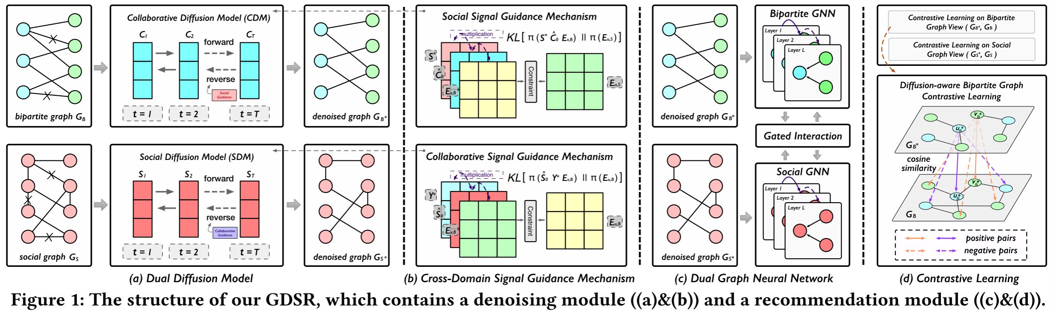
ChongqingUniversity of Technology
ATAI
AdvancedTechniqueof
Artificial Intelligence
ATAI
ChongqingUniversity _{AdvancedTechniqueof}
of Technology Artificial Intelligence
Overview

Slide 4
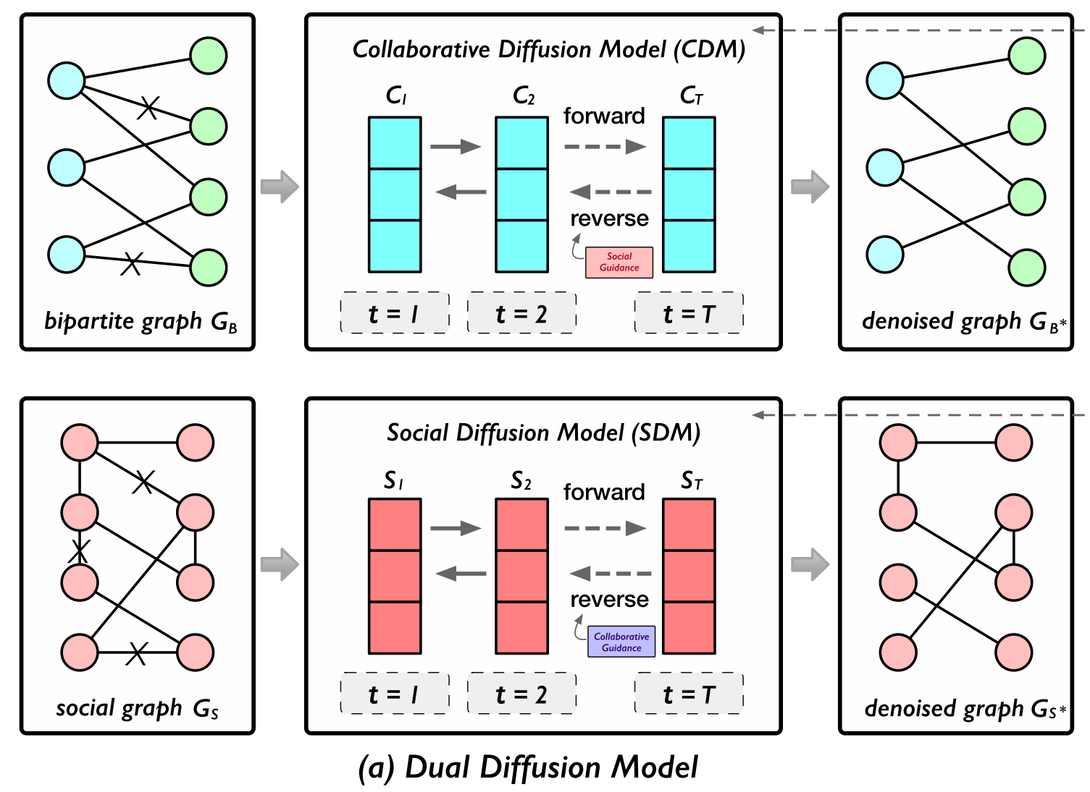
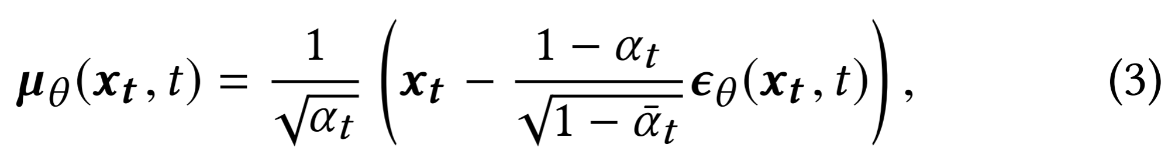
ChongqingUniversity of Technology
ATAI
AdvancedTechniqueof
Artificial Intelligence
ATAI
ChongqingUniversity _{AdvancedTechniqueof}
of Technology Artificial Intelligence
Method

Slide 5
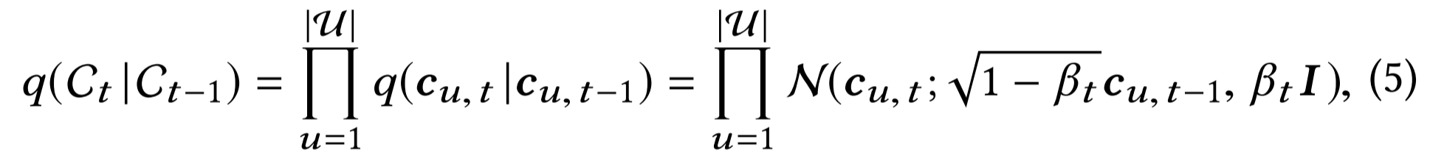
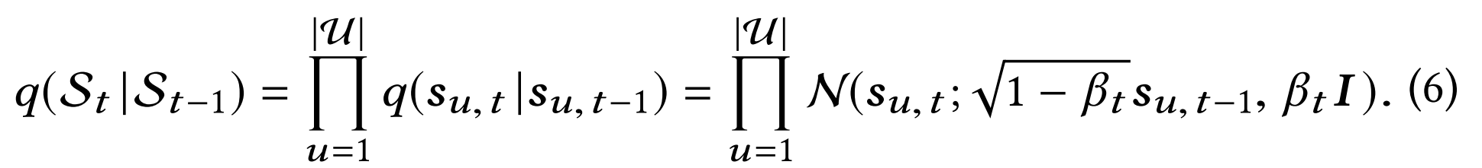
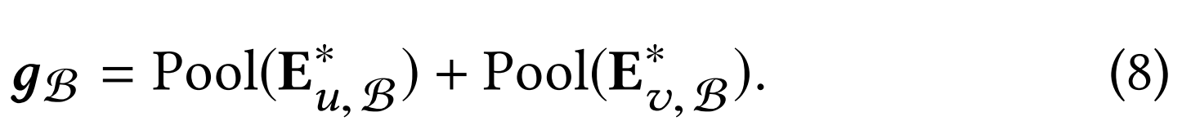
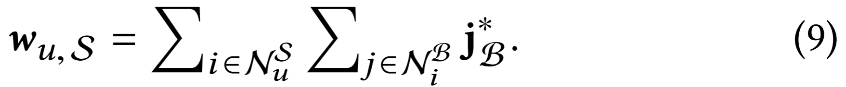
ChongqingUniversity of Technology
ATAI
AdvancedTechniqueof
Artificial Intelligence
ATAI
ChongqingUniversity _{AdvancedTechniqueof}
of Technology Artificial Intelligence
Method

Slide 6
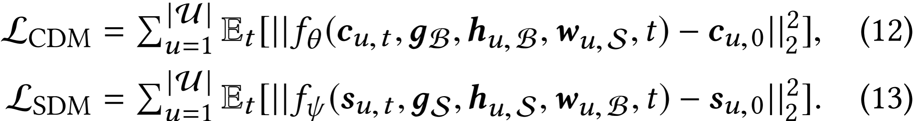
ChongqingUniversity of Technology
ATAI
AdvancedTechniqueof
Artificial Intelligence
ATAI
ChongqingUniversity _{AdvancedTechniqueof}
of Technology Artificial Intelligence
Method

Slide 7
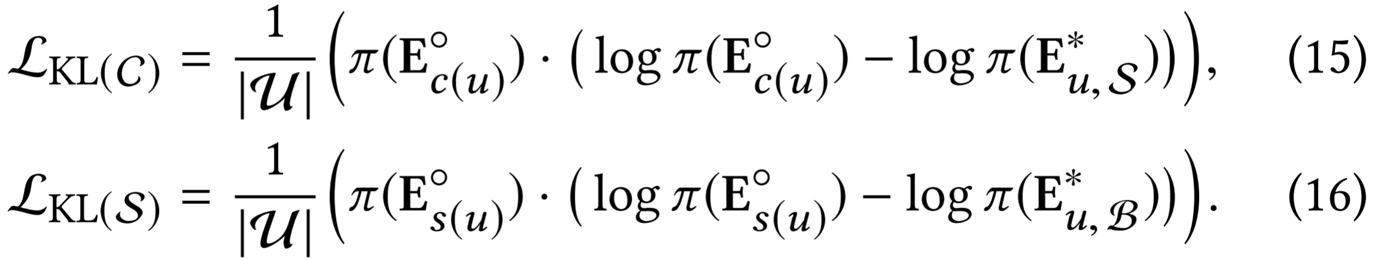
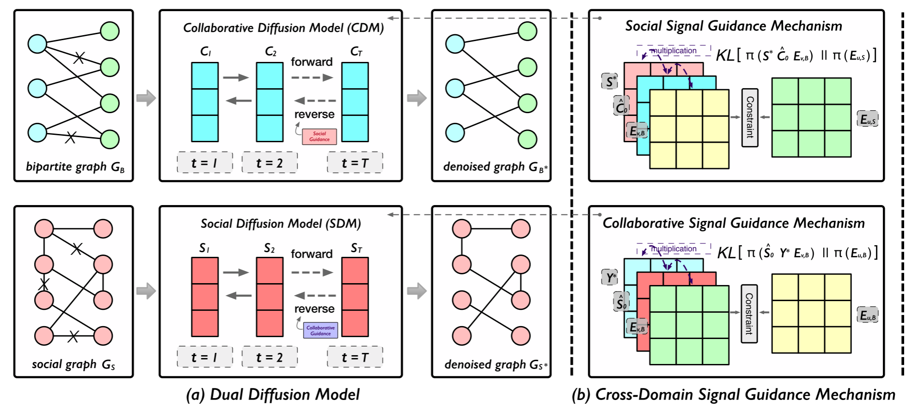
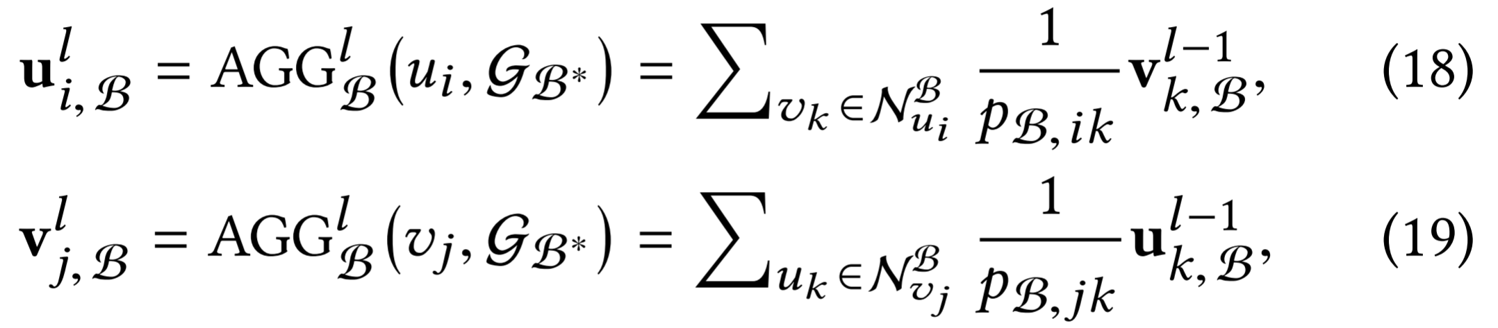
ChongqingUniversity of Technology
ATAI
AdvancedTechniqueof
Artificial Intelligence
ATAI
ChongqingUniversity _{AdvancedTechniqueof}
of Technology Artificial Intelligence
Method

Slide 8
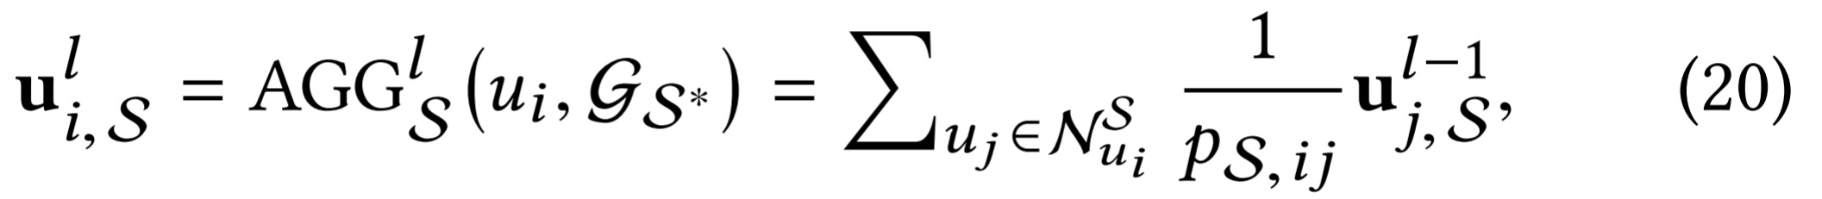
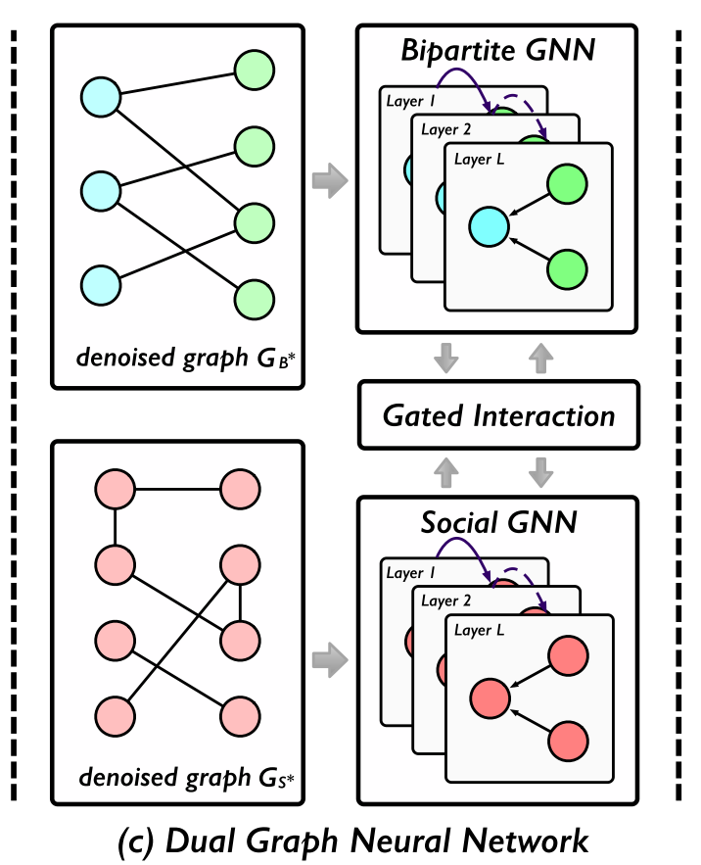
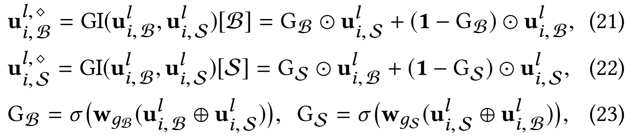
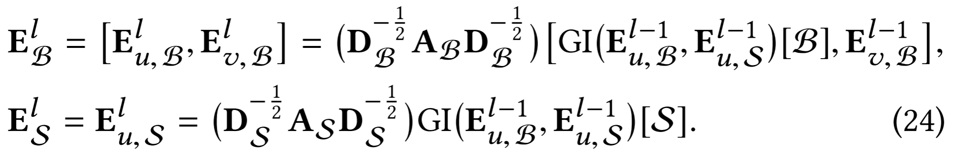
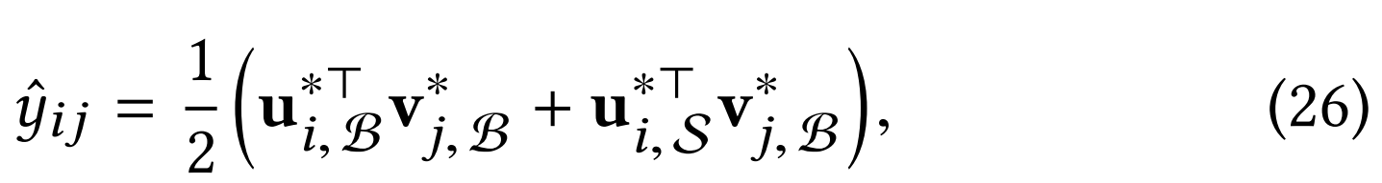
ChongqingUniversity of Technology
ATAI
AdvancedTechniqueof
Artificial Intelligence
ATAI
ChongqingUniversity _{AdvancedTechniqueof}
of Technology Artificial Intelligence
Method

Slide 9
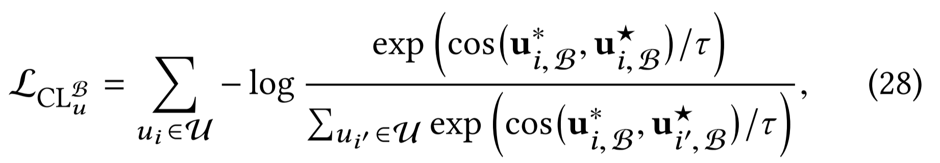
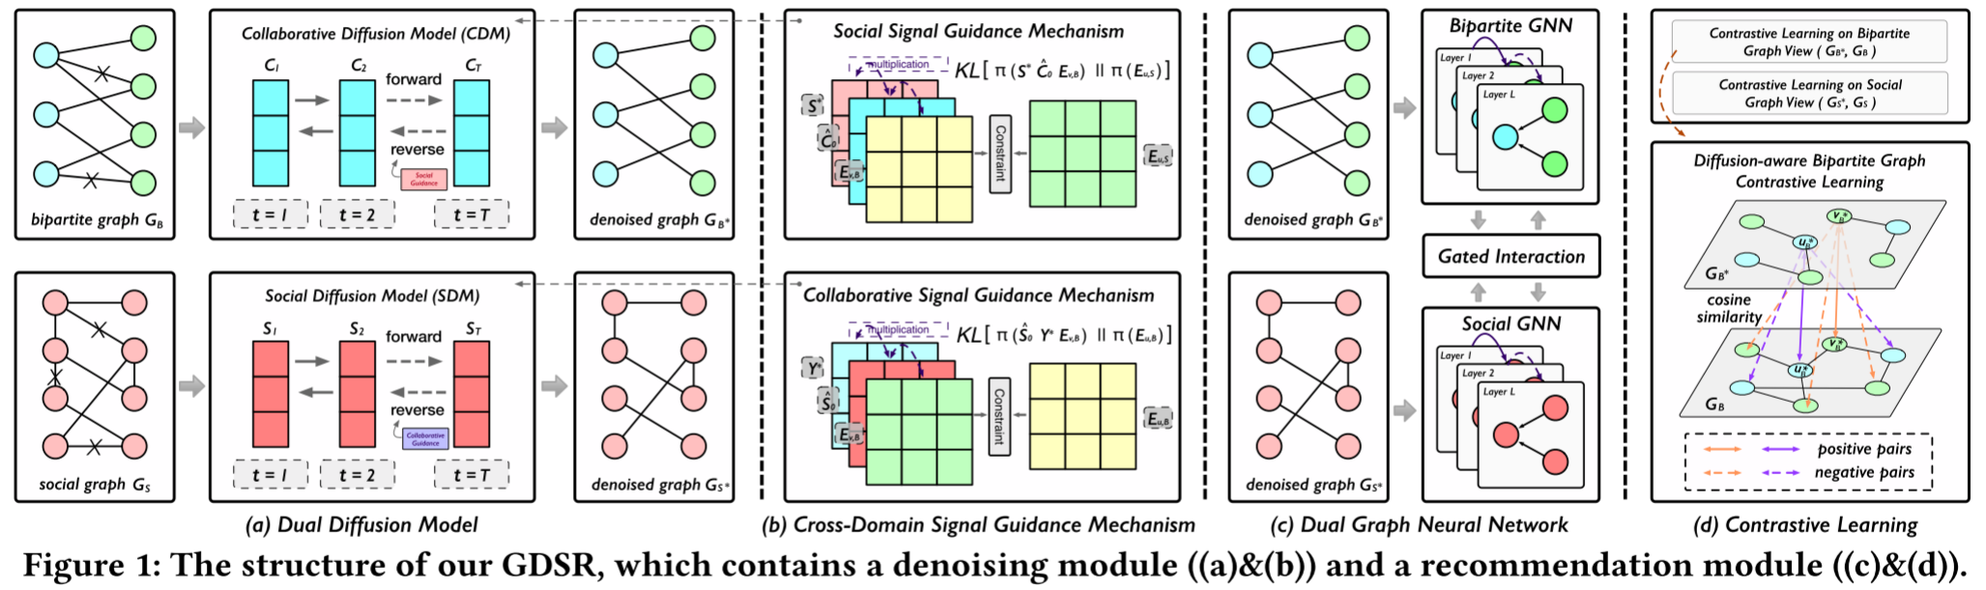
ChongqingUniversity of Technology
ATAI
AdvancedTechniqueof
Artificial Intelligence
ATAI
ChongqingUniversity _{AdvancedTechniqueof}
of Technology Artificial Intelligence
Method

Slide 10

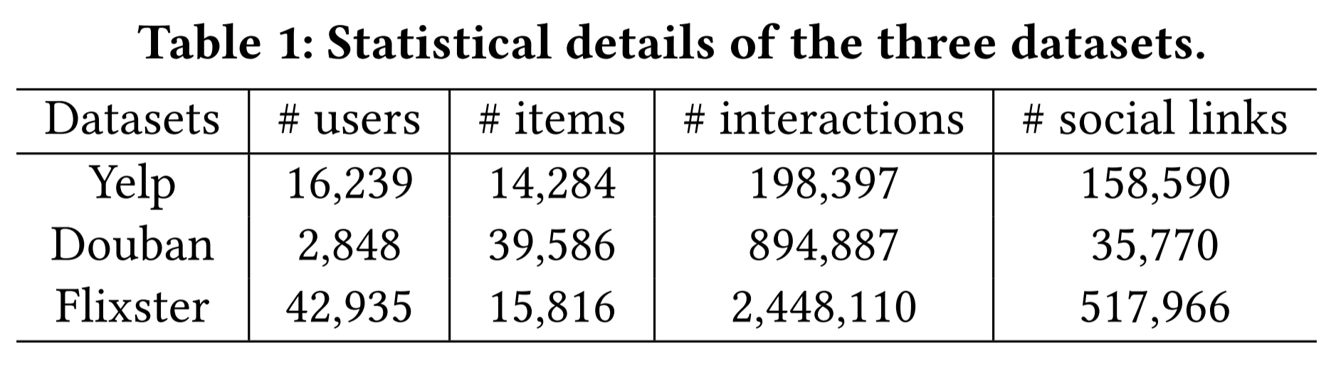
ATAI
AdvancedTechniqueof
Artificial Intelligence
ATAI
ChongqingUniversity _{AdvancedTechniqueof}
of Technology Artificial Intelligence
ChongqingUniversity of Technology
Experiments

Slide 11
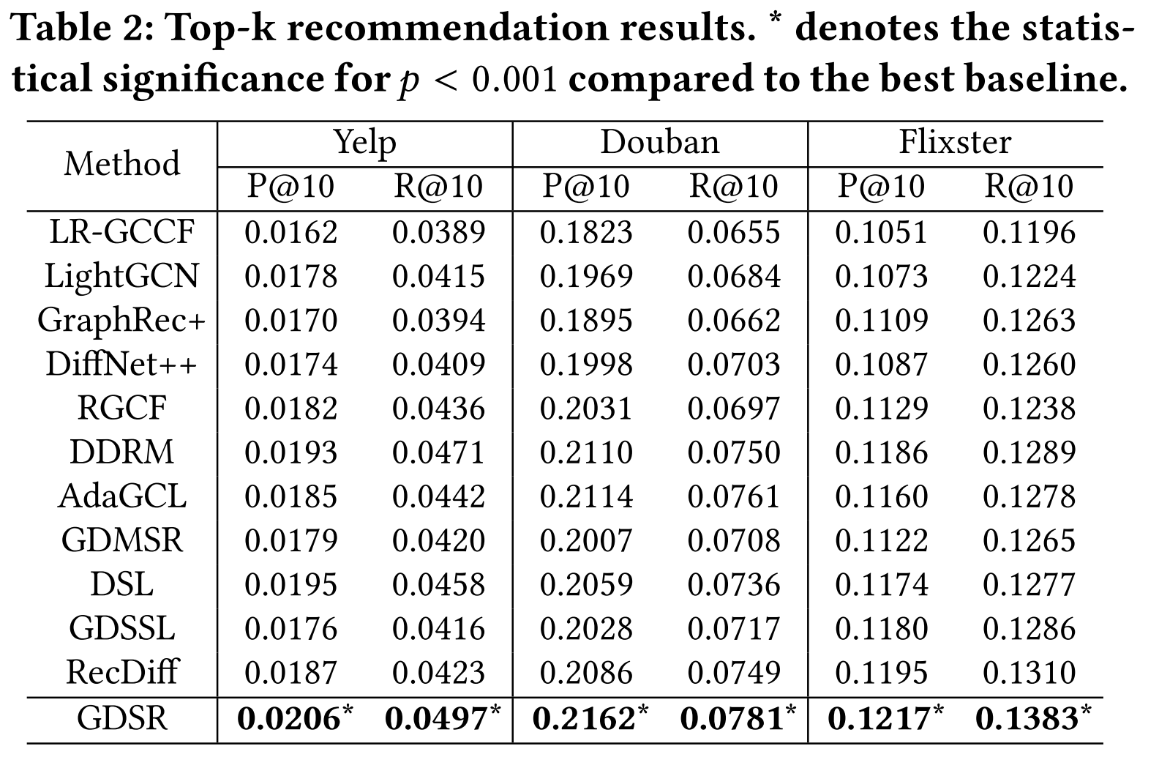
ATAI
AdvancedTechniqueof
Artificial Intelligence
ATAI
ChongqingUniversity _{AdvancedTechniqueof}
of Technology Artificial Intelligence
ChongqingUniversity of Technology
Experiments

Slide 12
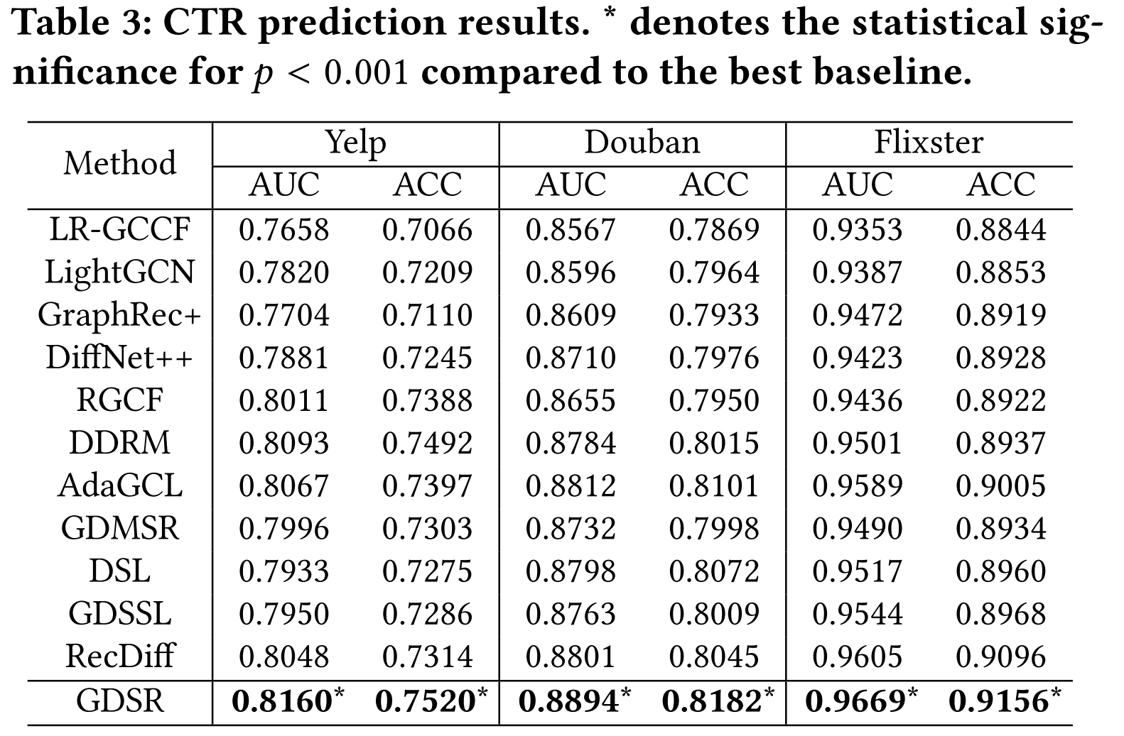
ATAI
AdvancedTechniqueof
Artificial Intelligence
ATAI
ChongqingUniversity _{AdvancedTechniqueof}
of Technology Artificial Intelligence
ChongqingUniversity of Technology
Experiments

Slide 13
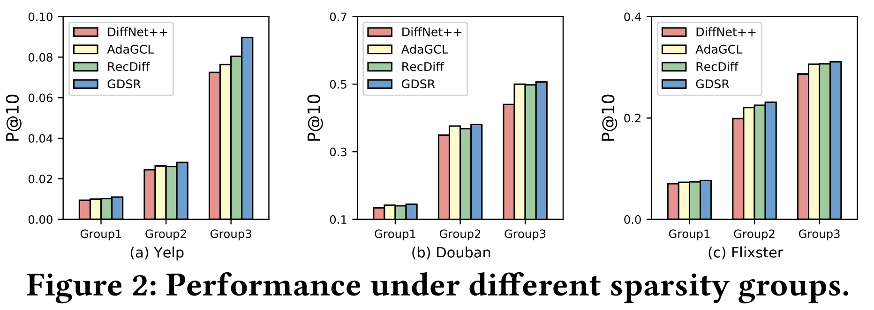
ATAI
AdvancedTechniqueof
Artificial Intelligence
ATAI
ChongqingUniversity _{AdvancedTechniqueof}
of Technology Artificial Intelligence
ChongqingUniversity of Technology
Experiments

Slide 14
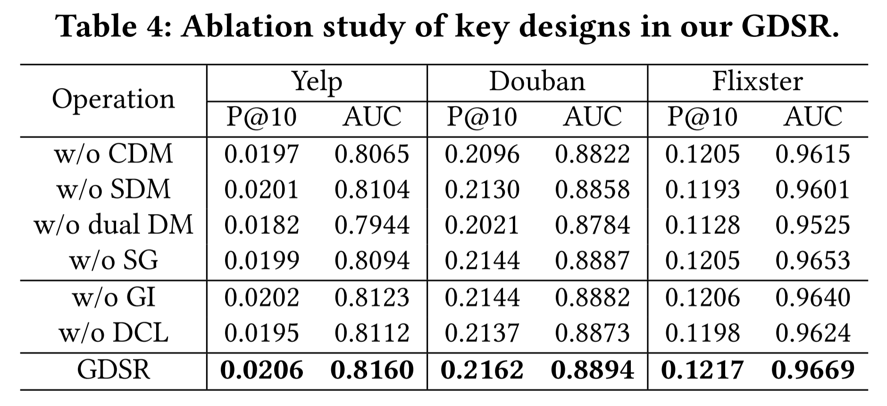
ATAI
AdvancedTechniqueof
Artificial Intelligence
ATAI
ChongqingUniversity _{AdvancedTechniqueof}
of Technology Artificial Intelligence
ChongqingUniversity of Technology
Experiments

Slide 15
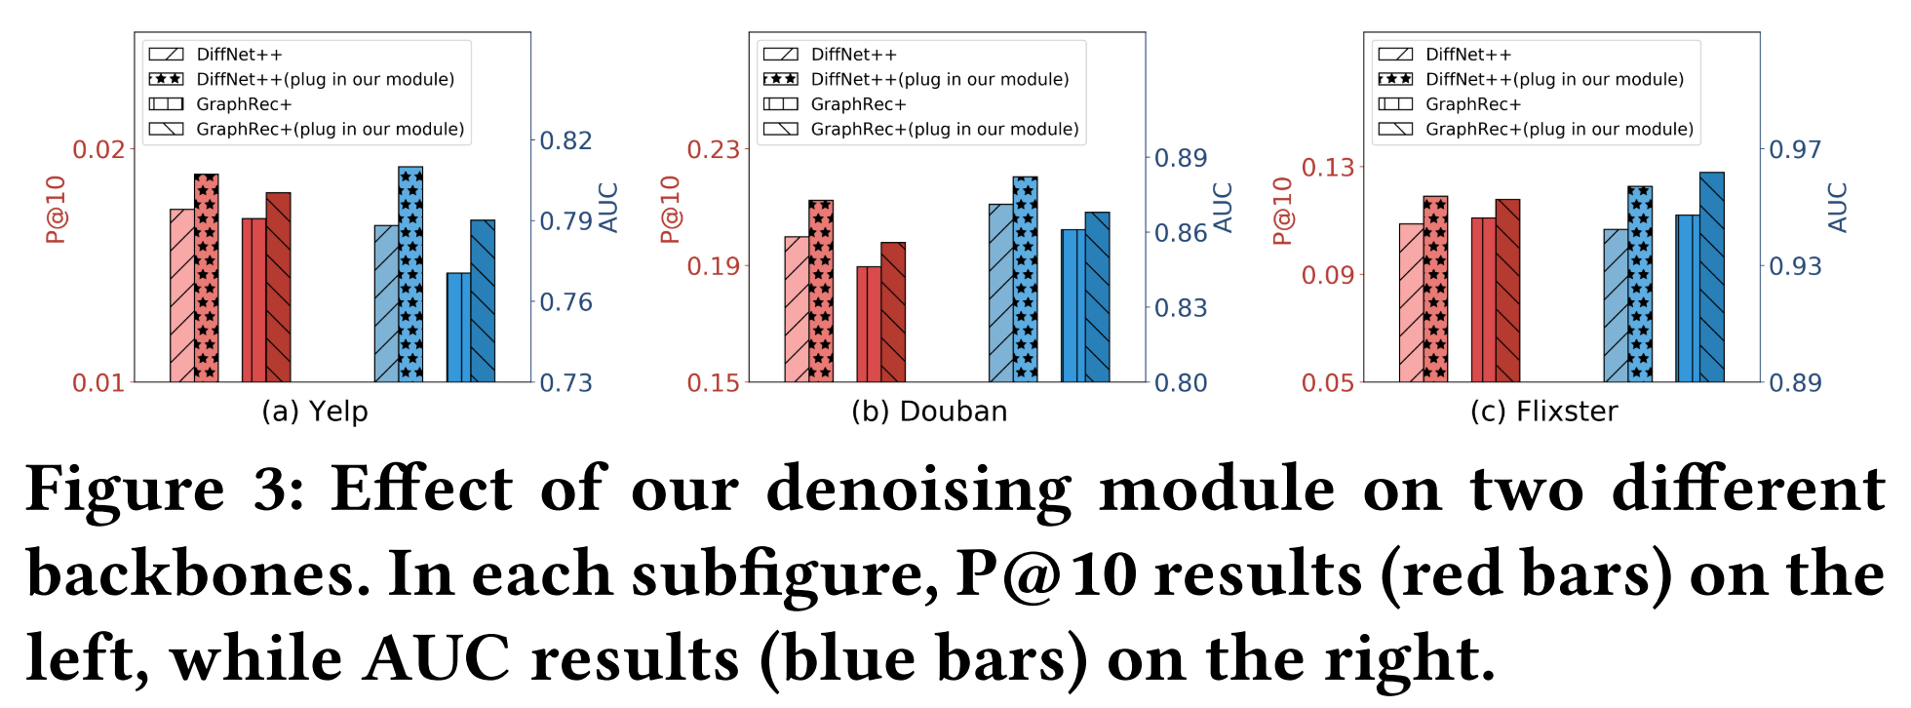
ATAI
AdvancedTechniqueof
Artificial Intelligence
ATAI
ChongqingUniversity _{AdvancedTechniqueof}
of Technology Artificial Intelligence
ChongqingUniversity of Technology
Experiments

Slide 16
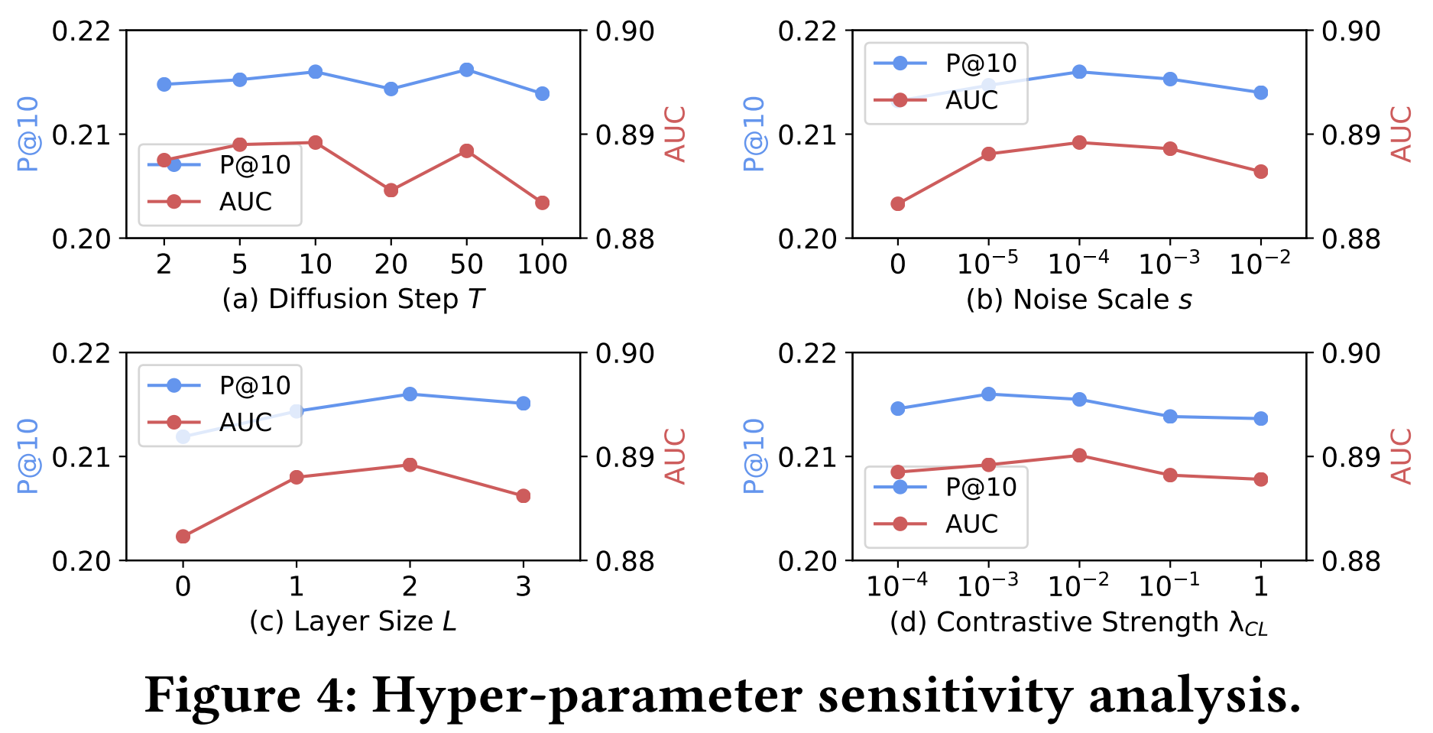
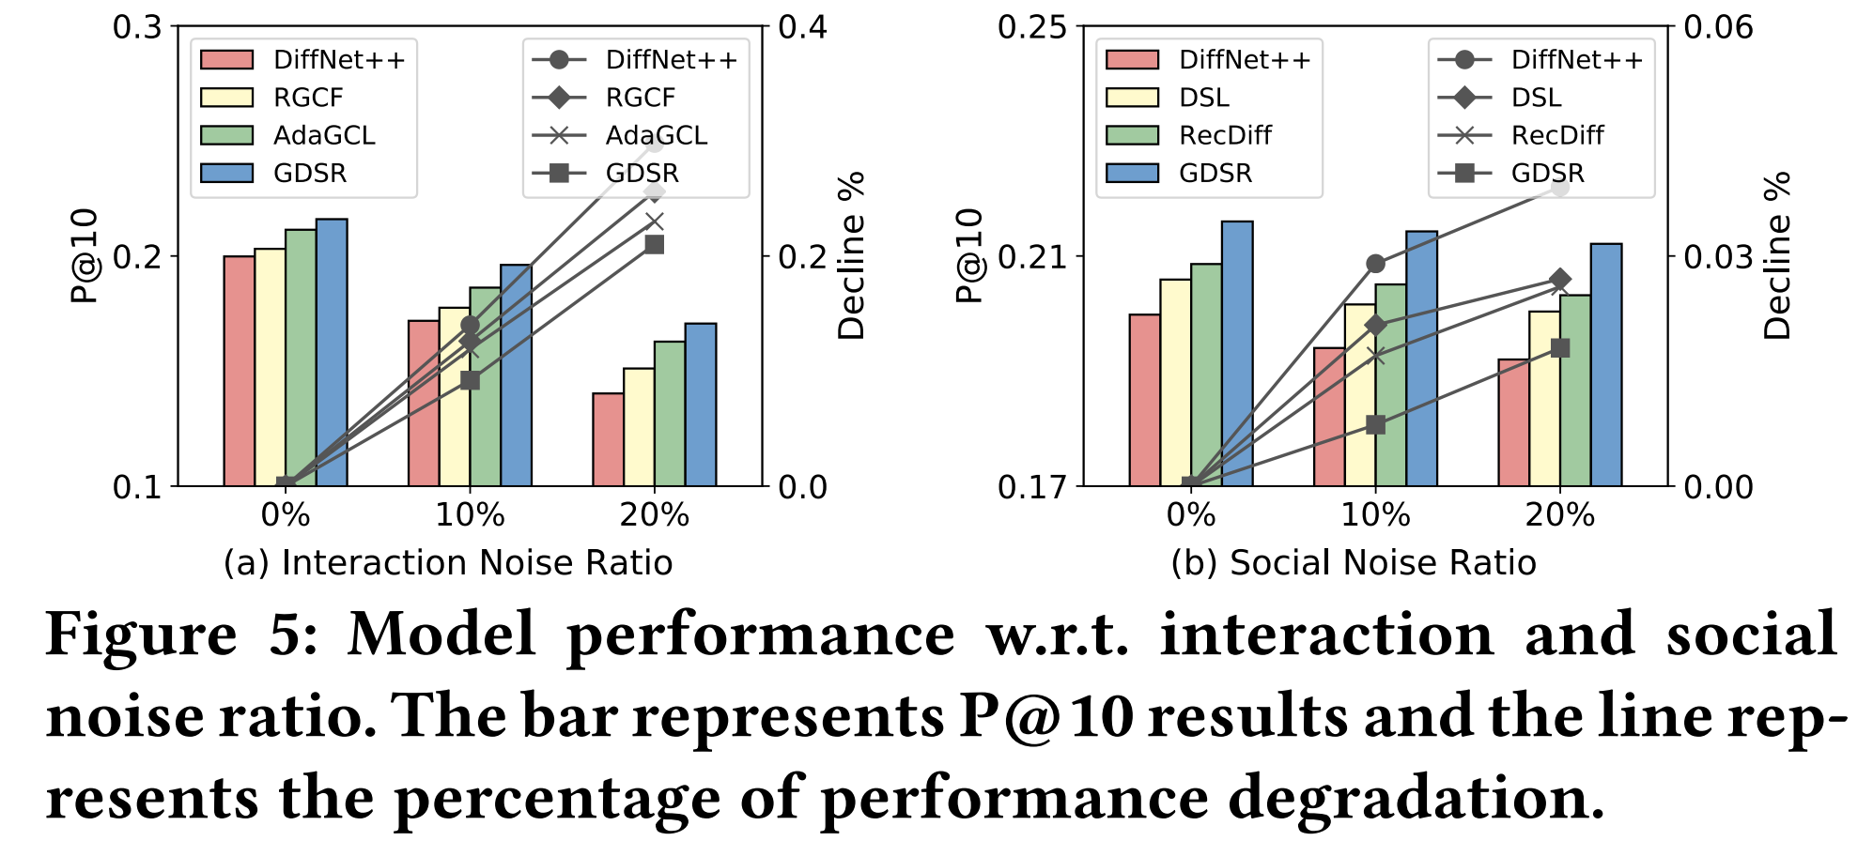
ATAI
AdvancedTechniqueof
Artificial Intelligence
ATAI
ChongqingUniversity _{AdvancedTechniqueof}
of Technology Artificial Intelligence
ChongqingUniversity of Technology
Experiments

Slide 17
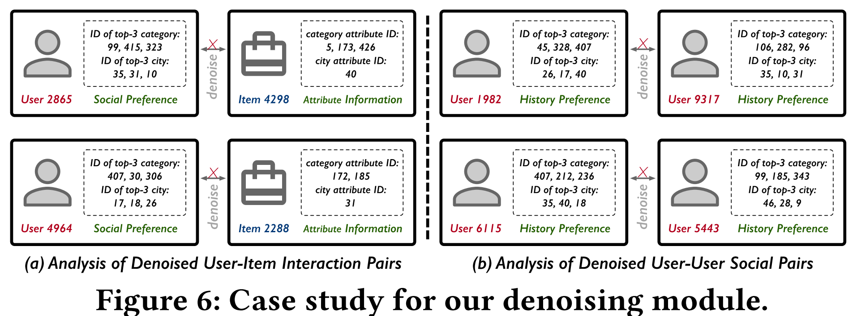
ATAI
AdvancedTechniqueof
Artificial Intelligence
ATAI
ChongqingUniversity _{AdvancedTechniqueof}
of Technology Artificial Intelligence
ChongqingUniversity of Technology
Experiments

Slide 18
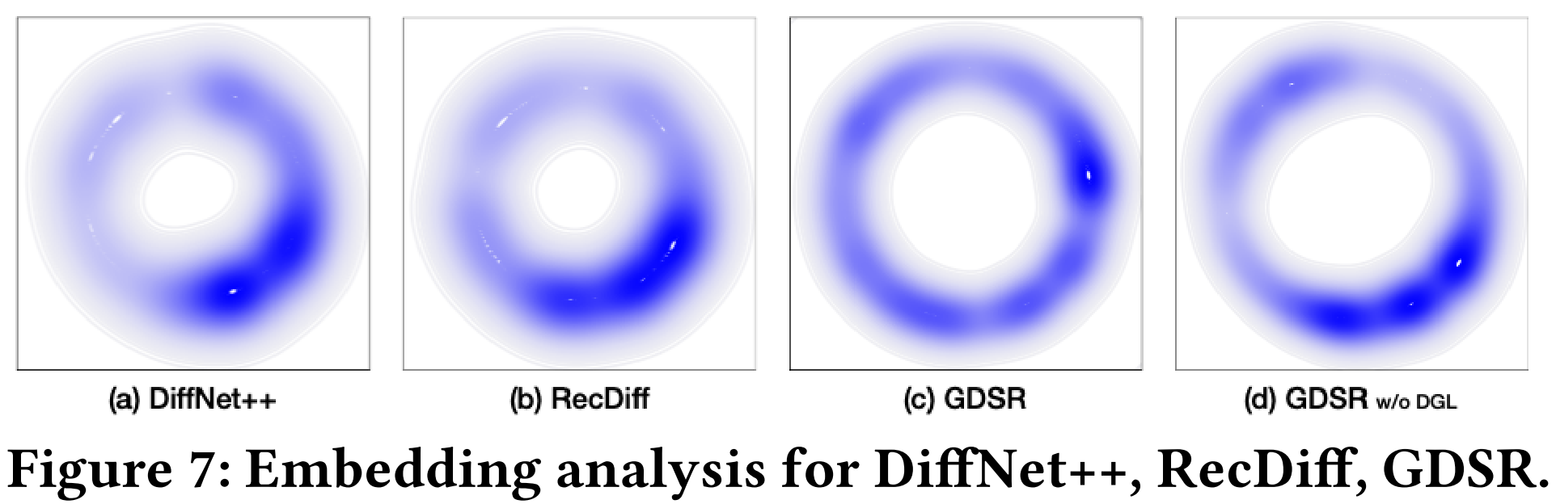
ATAI
AdvancedTechniqueof
Artificial Intelligence
ATAI
ChongqingUniversity _{AdvancedTechniqueof}
of Technology Artificial Intelligence
ChongqingUniversity of Technology
Experiments

Slide 19


ChongqingUniversity of Technology
ATAI
AdvancedTechniqueof
Artificial Intelligence
ATAI
ChongqingUniversity _{AdvancedTechniqueof}
of Technology Artificial Intelligence
Thanks!

